Slide 1
Telehealth and Telemedicine
January 23, 2016
James Coviello, MD
Andrew Moleski
Brook Watts, MD, MS

Slide 2
Agenda
Introduction and Overview
Telemedicine at the VA
UH Telemedicine Development
Q&A

Slide 3
Telemedicine and Telehealth
Telemedicine: The use of technologies to remotely diagnose, monitor, and treat patients
Telehealth: The application of technologies to help patients manage their own illnesses through improved self-care and access to education and support systems
Source: Connected Health: A Review of Technologies and Strategies to Improve Patient Care with Telemedicine and Telehealth; Health Affairs 2014

Slide 4







What is Telemedicine?
Use Cases May Be Achieved Across Multiple Modalities
Telehealth Use Cases, Relevant Modalities, and Investment Required
Education & Engagement
Ongoing Monitoring
& Care Coordination
Professional Consultation
Diagnosis & Treatment
Use Cases
Modalities
Videoconference
Asynchronous Store-and-Forward
Remote Device
Telephone
Patient
Portal
Mobile App
Need software, secure internet access for patients
Home and hospital-based technology
Need additional bandwidth, storage space
Can replace non-urgent phone calls and visits
More expensive hardware investment
Used for high-risk patients in non-hospital site
Little tech investment, requires proper staffing
Used for pre-visit triage
High security needs require significant investment
Must integrate EHR
Minimal hardware investment for providers
Complex security and data storage issues
Source: Marketing and Planning Leadership Council interviews and analysis. (Advisory Board)

Slide 5


More Services Being Provided Virtually
Services Can be Offered at a Lower Cost
Physical Exam
Urinary Tract Infection
Cut, Sprain, Fracture
Minor Cough, Cold
Complex Infection
Prescription Refill
Remote
Emerging Areas
for Virtual Care
In-Person
Diagnoses, treatments follow reliable standard protocols based on evidence-based medicine
Suggested therapies are nearly always effective
Physical exam not required, visual exam adds nominal value
Diagnoses, treatments
more complex, may vary within disease category
Therapies may need careful selection and monitoring
Physical exam or diagnostic test required to correctly identify issue and select treatment
Intervention required
(i.e., immunization)
Management, Maintenance
Chronic disease checkups, follow-ups
Care plan updates
Specialist consults
Diagnosis, Treatment
Remote diagnostics
Self-guided interventions
Source: Marketing and Planning Leadership Council interviews and analysis. Advisory Board

Slide 6



Following Trial, Strong Preference for Virtual Care
Telehealth Pilot Shows Early Adopters Now Recruiting Early Majority
92%
Of a virtual visit provider’s patients said they would use the service again
Case in Brief: Medical Associates Clinic
Four-physician practice in Kentucky
Piloted the Me-Visit mobile app to offer online care for primary care and chronic condition follow up needs
In 30-month pilot, 20% of patients used the app, and 97% of users preferred the service to in-person care
91%
Of Zipnosis users would recommend the service to at least three friends
71%
Of midsized to large U.S. employers anticipate offering employees telehealth services within three years

Slide 7



Technology Getting Faster, More Widespread
Enables Growth in Telehealth
Advancements in Technology
Increased Population
Remote monitoring devices with cellular or fixed-line modems enabling data transmission without computer or smartphone
Expanded memory and processing capabilities
Geospatial tracking
Movement tracking
Touch-screen technologies
100% US population covered by mobile network
Health information fastest-growing content accessed by US mobile users, up 134% between 2010-2011
Sources: “mHealth in an mWorld: How mobile technology is transforming health care,” Deloitte, available at http://www.deloitte.com/; Health Care IT Advisor research and analysis

Slide 8
Examining CMS Coverage Requirements
Specific Criteria Must be Satisfied to Qualify for Reimbursement
Core Eligibility Requirements for CMS Reimbursement
1
Geographic Location of Receiving Site
2
Type of Health Provider Delivering Service
3
Type of Institution Delivering Service
Must be provided to an eligible beneficiary in an eligible site
Site must be located outside of a Metropolitan Statistical Area
Eligible sites do not include a patient’s home
Physician
Nurse practitioner
Physician assistant
Nurse midwife
Clinical nurse specialist
Clinical psychologist
Clinical social worker
Registered dietitian or nutrition professional
Office of a physician or practitioner
Hospital
Rural health clinic
FQHC1
Skilled nursing facility
Hospital-based dialysis center
Community mental health center
Sources: “Medicare Telehealth Payment Eligibility Analyzer,” U.S. Department of Health and Human Resources, http://datawarehouse.hrsa.gov/telehealthAdvisor/telehealthEligibility.aspx; Cardiovascular Roundtable research and analysis.

Slide 9
Telemedicine in Ohio
Private insurers are not mandated to cover telemedicine visits
Limited coverage by Medicare
Medicaid reimbursement for live consults began January 2015
OhioHealth and Ohio State have well-established and expansive Telestroke networks
VA has the largest telemedicine program in the U.S.
Cleveland VA Medical Center has the 2nd largest telemedicine program in the VA

Slide 10
Cleveland VAMC
Telehealth Use Cases, Relevant Modalities, and Investment Required
Education & Engagement
Ongoing Monitoring
& Care Coordination
Professional Consultation
Diagnosis & Treatment
Use Cases
Modalities
Videoconference
Asynchronous Store-and-Forward
Remote Device
Telephone
Patient
Portal
Mobile App
Need software, secure internet access for patients
Home and hospital-based technology
Need additional bandwidth, storage space
Can replace non-urgent phone calls and visits
More expensive hardware investment
Used for high-risk patients in non-hospital site
Little tech investment, requires proper staffing
Used for pre-visit triage
High security needs require significant investment
Must integrate EHR
Minimal hardware investment for providers
Complex security and data storage issues
Source: Marketing and Planning Leadership Council interviews and analysis. (Advisory Board)

Slide 11
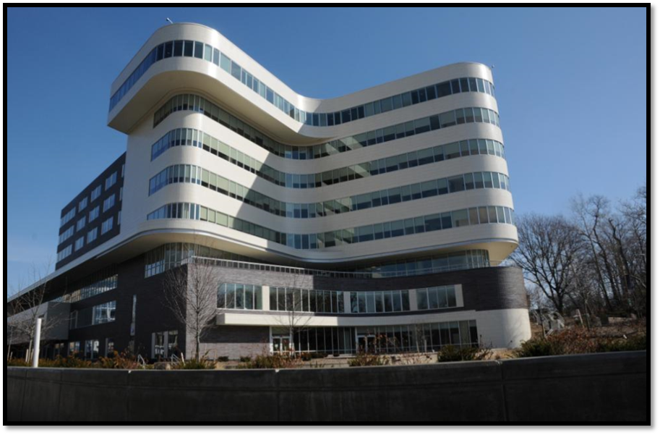
Cleveland VAMC FY15
3rd most complex VHA facility in the country
Total Unique Patients : 109,962
  34% are classified as Rural Patients
Admissions: 10,416; ADC: 508
Outpatient Encounters: 1,965,061
Outpatient Visits: 1,480,712
Notes:
The Cleveland VA health system delivers “soup to nuts care” Primary and specialist care; home care; long term care; hospice care; specialist and surgical care. Mental health care. Homeless services, dialysis care. Electronic medical record provides seamless communication

Slide 12
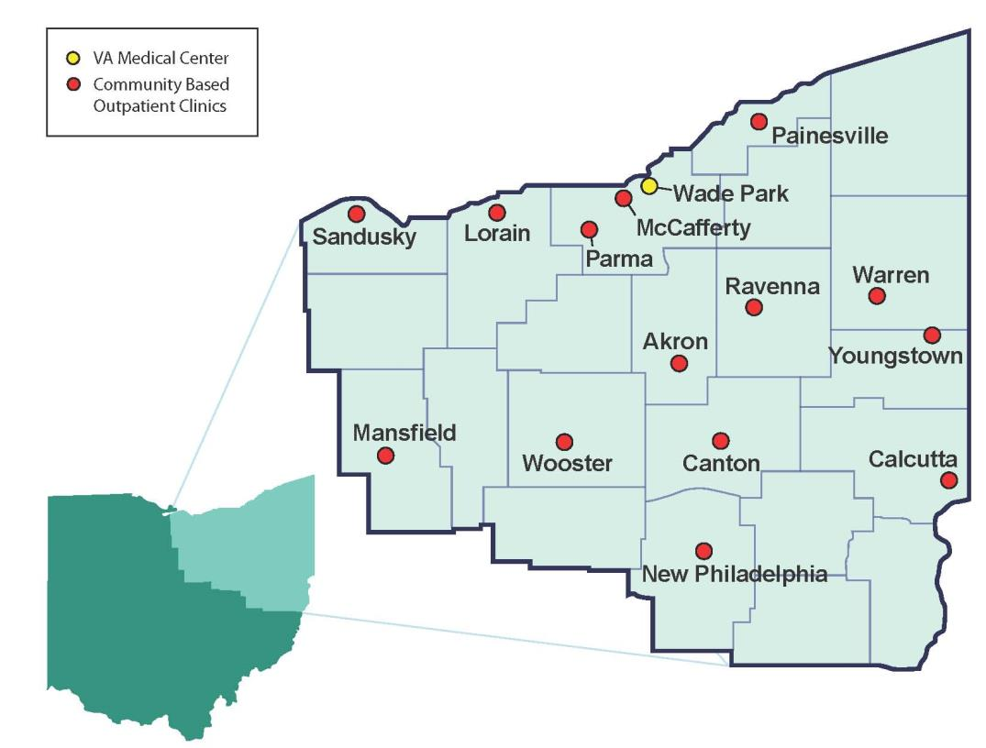
Areas We Serve
The Louis Stokes Cleveland VAMC
provides care for 110,000 Veterans residing in 24 counties
Notes:
Our population is all enrolled Veterans who reside in these 24 counties in Ohio, plus Veterans who live outside our cachement area but are referred to us for specialty care. Our electronic medical record, VISTA, provides an integrated inpatient and outpatient electronic health record for VA patients, and administrative tools.

Slide 13
Cleveland VAMC
Home Telehealth – Unique Patients

Slide 14
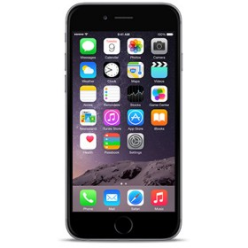
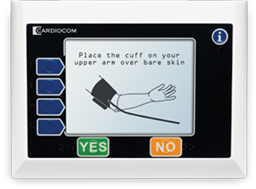

Cleveland VAMC
Home Telehealth
Diagnoses
  Diabetes
  CAD
  CHF
  COPD
  Hypertension
  Spine Cord Injury
  Depression
  Schizophrenia
  PTSD
  Bipolar
  Dementia
  Low ADL
  MOVE!
  Smoking Cessation
  Substance Abuse
Daily monitoring
Easy to use and transport
Interactive Voice Response

Slide 15
Cleveland VAMC
Clinical Video Telehealth

Slide 16
Cleveland VAMC
Clinical Video Telehealth
  Tele-Nutrition
  Tele-Traumatic Brain Injury
  Tele-Audiology
  Tele-Speech Pathology
  Tele-Physical Therapy
  Tele-Occupational Therapy
  Tele-Blind Rehab
  Tele-Spinal Cord Injury
  Tele-Amputation
  Tele-Urology
  Tele-Diabetes
  Tele-Gastroenterology
  Tele-Pulmonary
  Tele-Nephrology
  Tele-Neurology
  Tele-Primary Care
  Tele-Genomic Medicine
  Tele-MOVE!
  Tele-Surgery
  Tele-Prosthetics
  Tele-Pharmacy
  Tele-Pain Medicine
  Tele-Mental Health
  Tele-Substance Abuse
  Tele-HUD/VASH
  Tele-PTSD
  Tele-PRRC
  Tele-Justice Outreach
  Tele-Physical Medicine
  Tele-Cardiology
  Tele-Orthotics
  Tele-Healthy Cooking

Slide 17
Cleveland VAMC
Store and Forward
    Tele-Retinal Imaging
    Tele-Dermatology
    Tele-Wound Care
    Tele-Spirometry

Slide 18
The Evidence (in one slide)
VA-specific
Circumstantial
Usually part of a complex intervention
Few randomized trials
. . .but patients like it

Slide 19
Telehealth vs Face-to-Face
  Cochrane review 2010
    Little evidence of clinical benefits (though no clear harms either)
    Cost effectiveness not clear
    Patients were satisfied
    . . . But only 7 trials met inclusion criteria (had to compare telemedicine to face-to-face)
19

Slide 20
Telemedicine at University Hospitals
Program | Classification | Leader
Online Scheduling | Patient Access | Maria Kamenos
Tele-Urgent Care | Direct to Consumer | Andrew Moleski
Tele-EPAT | Video Consult | Bob Ronis, MD
CEM Child Telepsych | Video Consult | John Hertzer, MD
Home Care Remote | Direct to Consumer | Keith Maitland
Rainbow Care Connection (Nurse Triage) | Population Health Mgmt Patient Access | Andrew Hertz, MD
Video Concierge | Patient Access | Maria Kamenos
Telestroke | Video Consult | Tony Furlan, MD
Transplant Institute | Patient Education | Barb Loiselle
Teleradiology | Store and Forward | Pablo Ros, MD
Maternal Fetal Medicine | Video Consult | Michelle Walsh, MD
Neonatology | Video Consult | Michelle Walsh, MD
Remote Second Opinion | Direct to Consumer | Erin Slay
Pediatric Specialty Consults | Video Consult | Robin Strosaker, MD
Emmi Solutions | Population Health Mgmt | Nate Hunt
UH Patient Portal | Direct to Consumer | Kathy LeBrew
Martii Virtual Translation | Patient Access | Ron Dziedzicki

Slide 21
Telehealth Opportunities for UH
 | Goal | Currently Generates Revenue | Gain Market Share | Improve Access | Improve Quality | Lower Costs/ Improve Efficiency | Manage Defined Populations (ACO and Direct Employer)
1 | Tele-Urgent Care | Yes | Yes | Yes | Yes | Yes | Yes
2 | Online Scheduling | Yes | Yes | Yes |  | Yes
3 | Clinical Video Telemedicine | Yes (Limited) | Yes | Yes | Yes | Yes | Yes
4 | Expanded Home Telemonitoring | No | Yes | Yes | Yes | Yes | Yes
5 | Remote ICU | Possible |  | Yes | Yes | Yes
6 | E-visits through Patient Portal | Possible | Yes | Yes |  | Yes | Yes
7 | Store and Forward Programs | Yes (Radiology Only) | Yes | Yes | Yes | Yes
Notes:
Urgent Care – MDLive
Online Scheduling – ZocDoc
Clinical Video Telemed – Pediatric IP, MFM, Neonatology, Telestroke

Slide 22
“If we scale the tele-health system to its full potential, it will become the dominant way that outpatient medicine is rendered.”
- Eric Topol, MD – Author of “The Patient Will See You Now”
“Before you become too entranced with gorgeous gadgets and mesmerizing video displays, let me remind you that information is not knowledge, knowledge is not wisdom, and wisdom is not foresight. Each grows out of the other, and we need them all.”
- Arthur C. Clarke

Slide 23
Q&A

